Slide 1
Master Thesis 2013
NUMERICAL EVALUATION OF
SUPPORTING STRUCTURES FOR TRAFFIC ROAD SIGNS UNDER CONSIDERETION
OF PASSIVE SAFETY REQUIREMENTS
ACCORDING TO EN 12767
Ioannis Petromichelakis
Supervisor:
Dipl.-Ing. Marco Götz
Dresden, 29/10/2013
Prof. Dr.-Ing. Wolfgang Graf

Slide 2
Content
1 Introduction
2 Numerical model
3 Crash test simulation
4 Consideration of uncertainties
5 Conclusions

Slide 3
Introduction
1 Introduction
2 Numerical model
3 Crash test simulation
4 Consideration of uncertainties
5 Conclusions

Slide 4
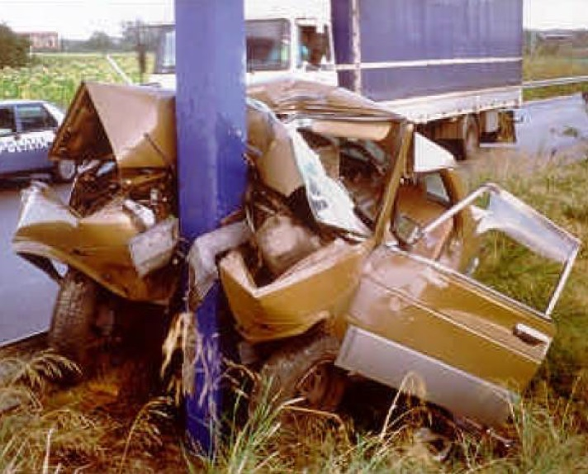
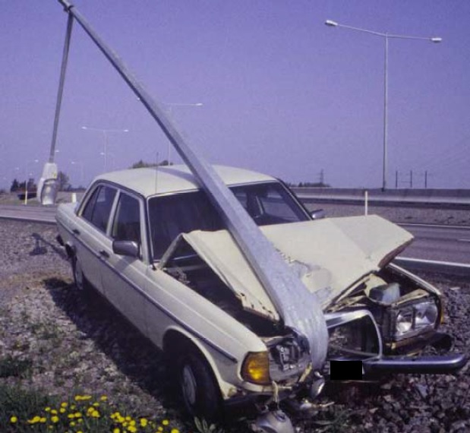
Introduction
Passive Safety
Non-passively safe column
Passively safe column

Slide 5
Introduction
EN 12767
Passive safety of support structures for road equipment
Impact test method
Standardization of the impact test
Speed classes
50 35 and 50 km/h
70 35 and 70 km/h
100 35 and 100 km/h
Classification of support structures
High Energy absorption (HE)
Low Energy absorption (LE)
No Energy absorption (NE)
Requirements
Predictable behaviour of the tested item
Limits for impact severity measures

Slide 6
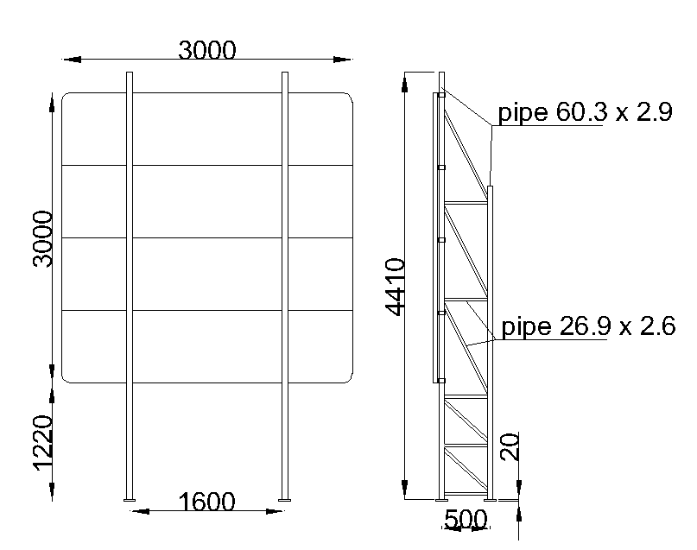
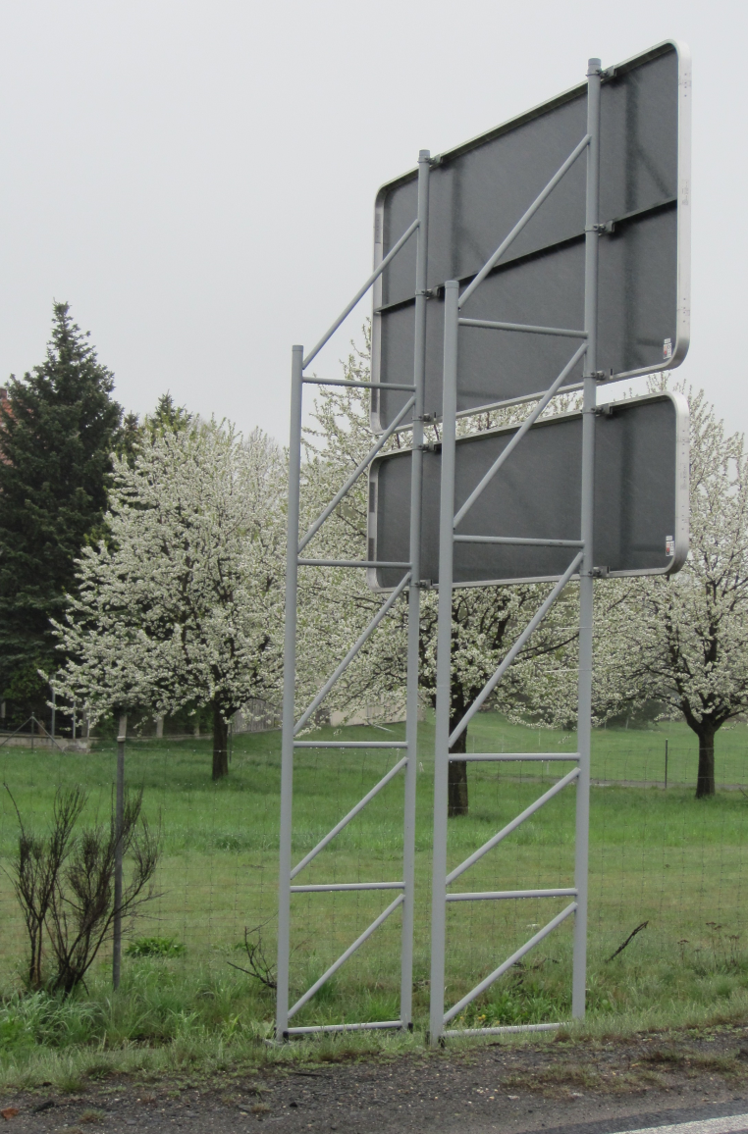
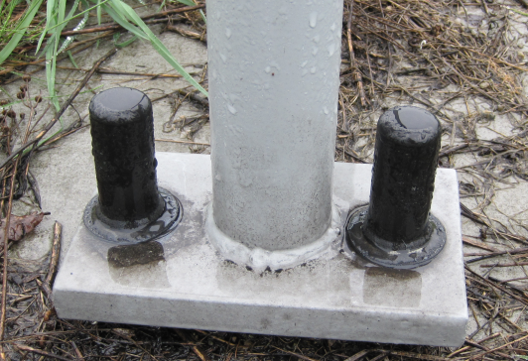
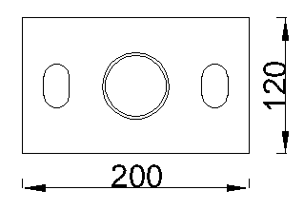
Introduction
The studied structure

Slide 7
Numerical model
1 Introduction
2 Numerical model
3 Crash test simulation
4 Consideration of uncertainties
5 Conclusions

Slide 8
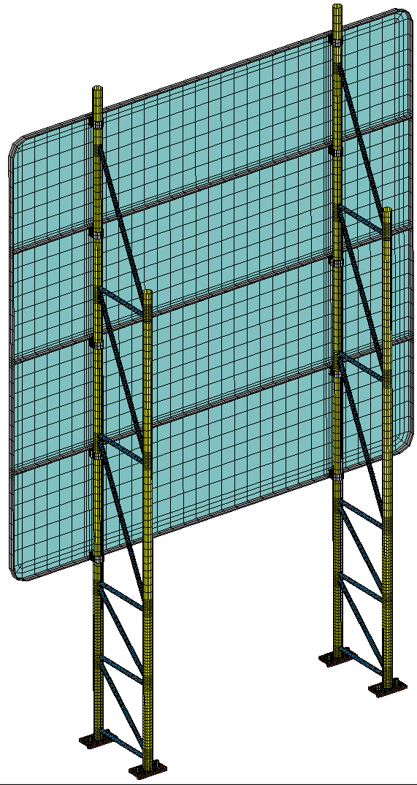
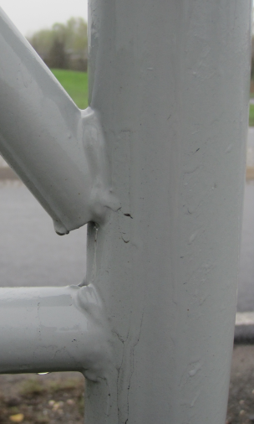
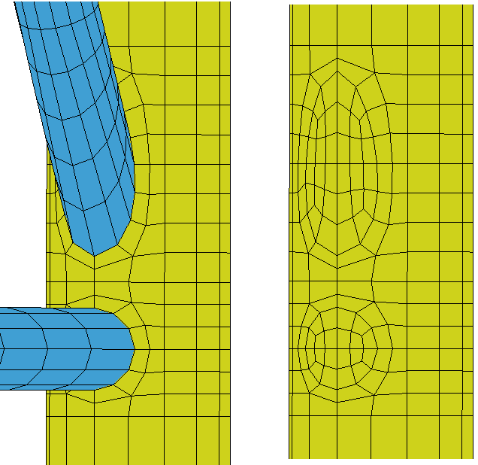
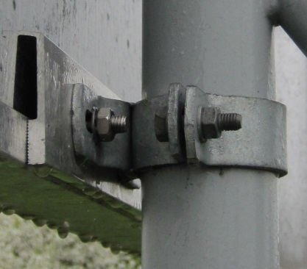
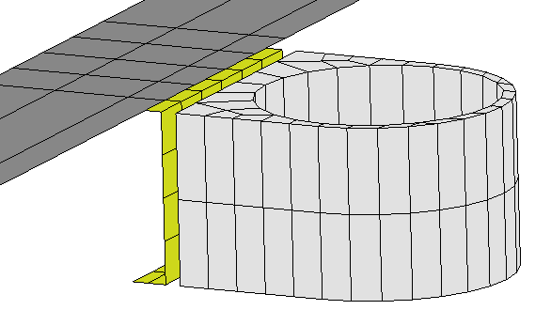
Numerical model
Numerical model of the structure

Slide 9
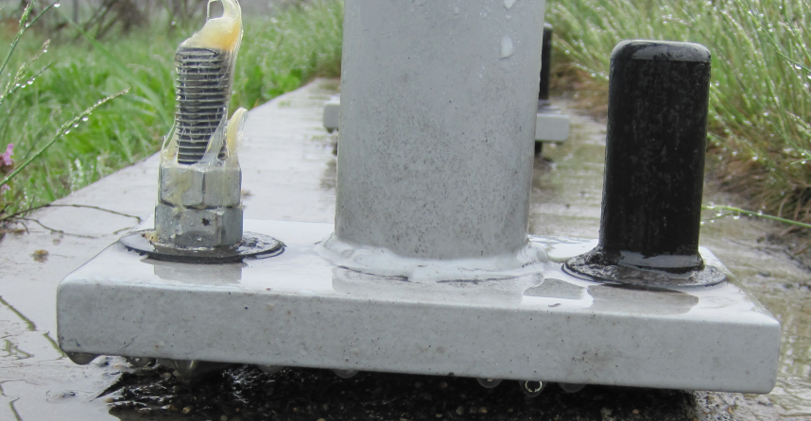
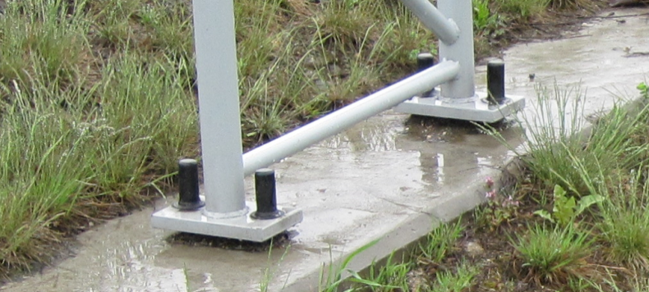
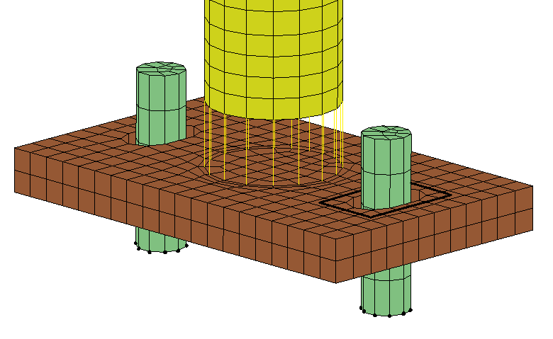
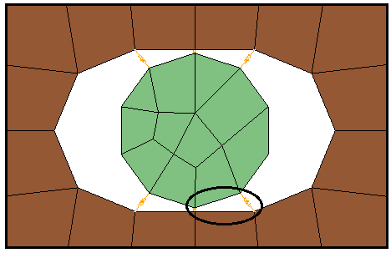
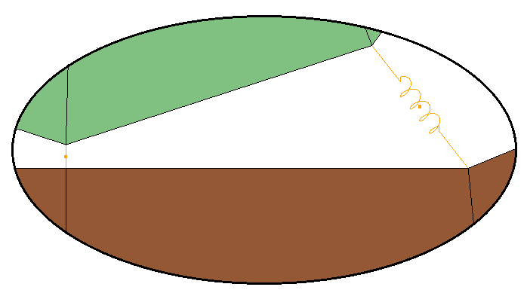
Numerical model
Base support
Elastic springs
Welds
Fixities

Slide 10
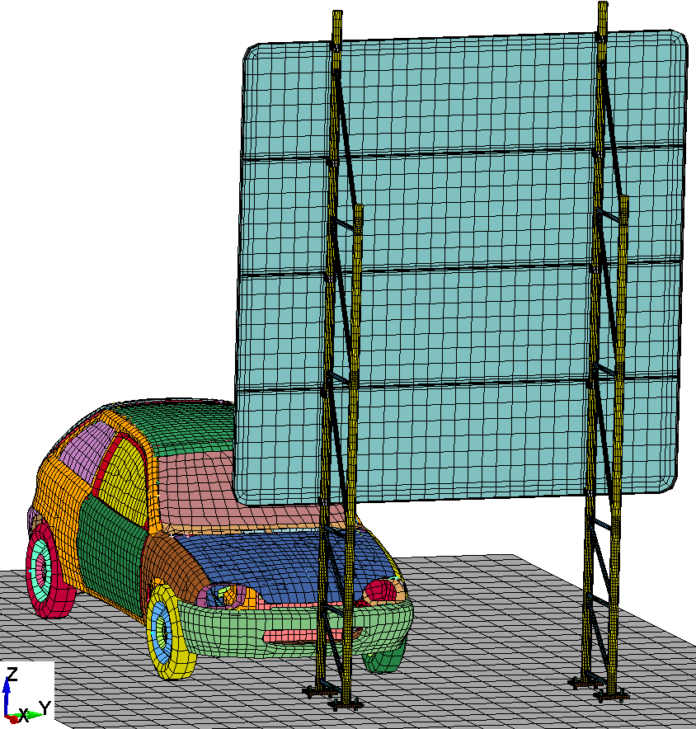
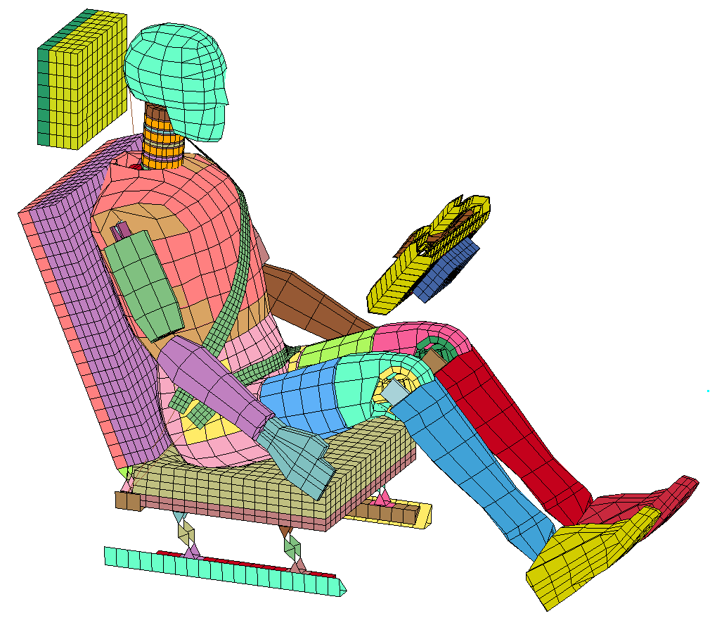
Numerical model
Simulation set-up

Slide 11
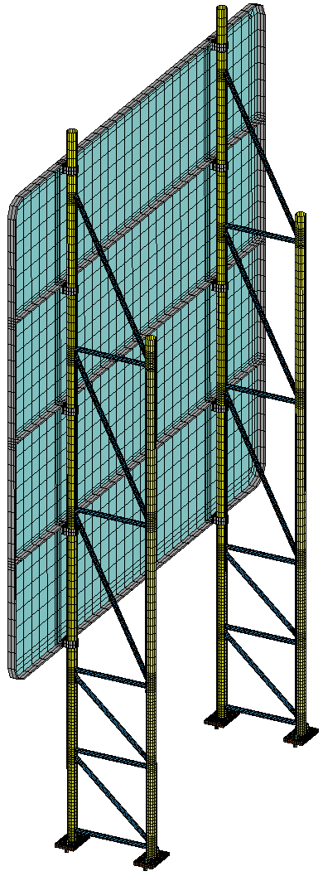
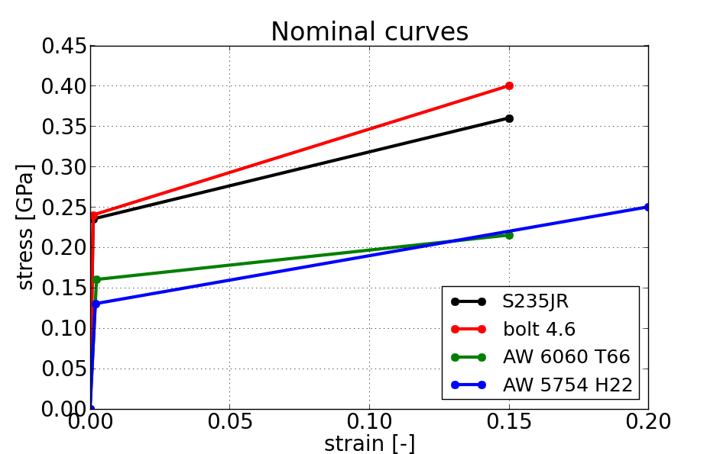
Numerical model
Materials

Slide 12
Crash test simulation
1 Introduction
2 Numerical model
3 Crash test simulation
4 Consideration of uncertainties
5 Conclusions

Slide 13
Crash test simulation
Impact tests using numerical simulation
Adopted and developed by the automotive industry to reduce the production cost
Accurate and efficient
Highly non-linear problem
Solution with Finite Element Analysis (FEA)
Commercial software LS-DYNA

Slide 14
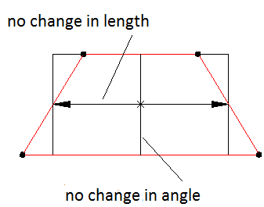
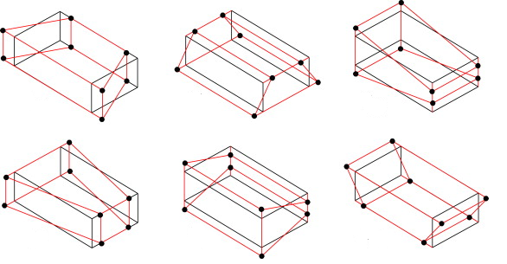
Crash test simulation
Finite Element Analysis (FEA)
Explicit time integration methods
One integration point elements
Hourglass effect

Slide 15
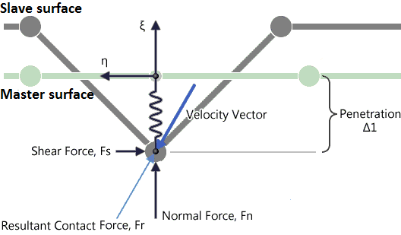
Crash test simulation
Contact/Impact – Penalty Method
$$F_{s}=c_{friction}∙|{\vec{F}}_{n}|$$
$${\vec{F}}_{n}= {\vec{F}}_{r}∙\hat{ξ}$$
$$F_{r}=0.1∙K_{m}∙Δ1$$

Slide 16
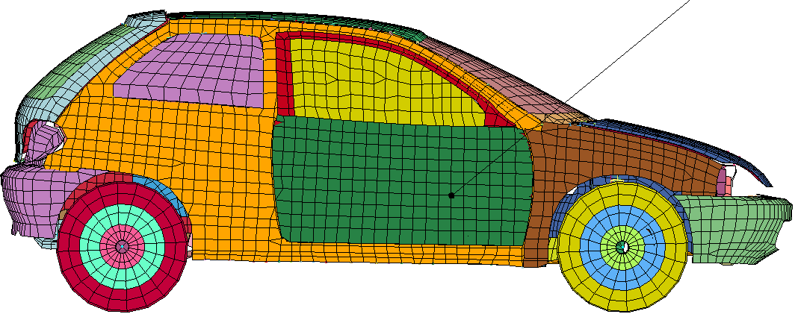
Crash test simulation
Impact indices
Head centre of mass
Injury Criteria (Euro NCAP)
Head Injury Criterion (HIC)
HIC36 measured at maximum 36 ms
Safety: < 560
Injury: > 840
Neck Injury Criterion (NIC)
Acceleration Severity Index (ASI)
Upper limits: 0.6 – 1.4
Theoretical Head Impact Velocity (THIV)
Impact Severity Indices (EN 12767)
Car centre of mass

Slide 17
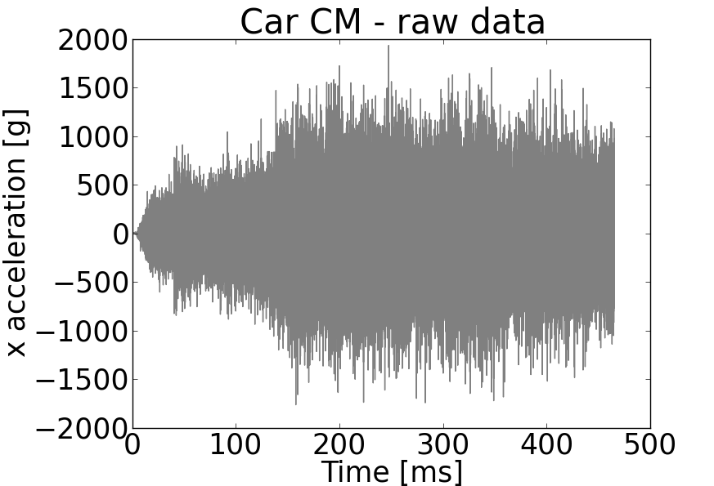
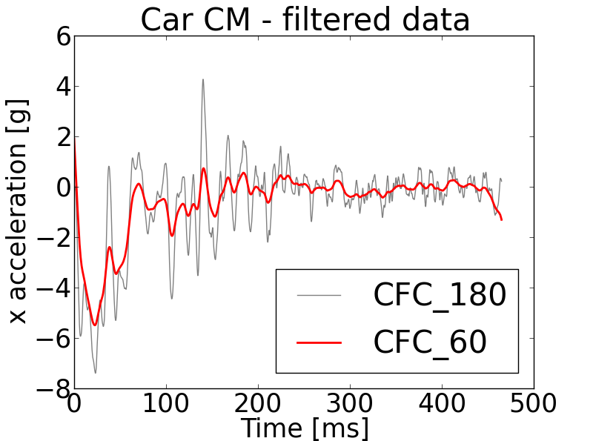
Crash test simulation
Filtering
Acceleration time-histories of particular nodes - high frequency components numerical noise
Solution filtering using low pass digital filter
Cut-off frequency of the filter - defined by the standards, e.g. CFC_180, CFC_1000, etc.

Slide 18
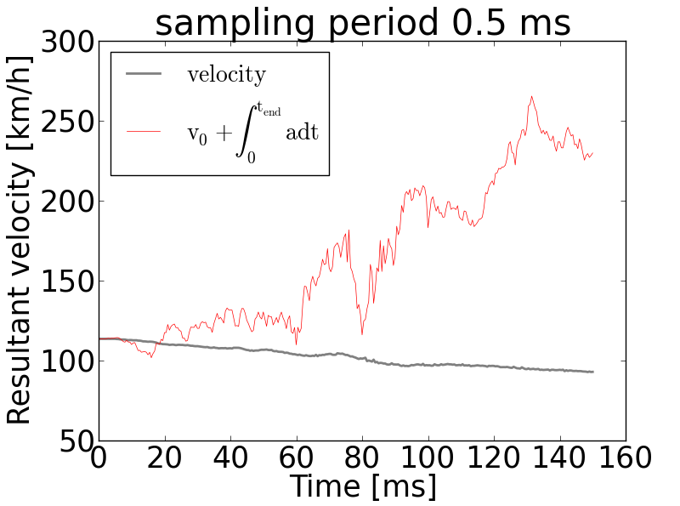
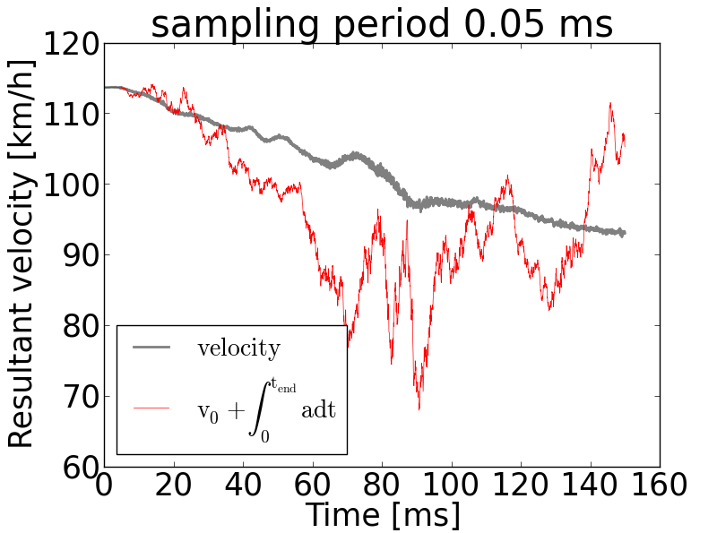
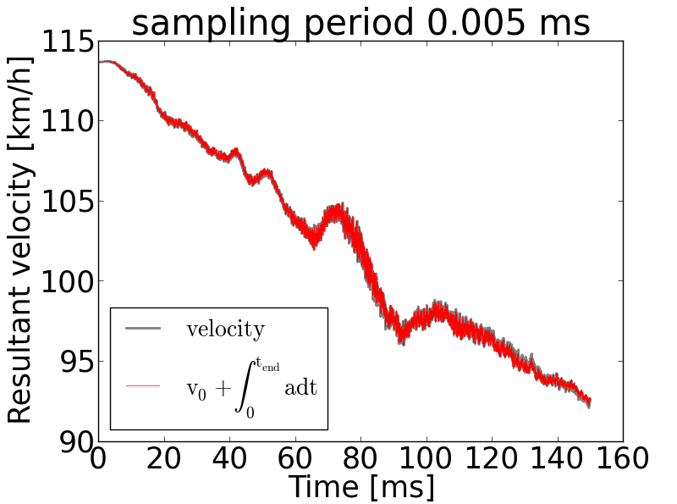
Crash test simulation
Integration of accelerations – Aliasing effect
Aliasing errors

Slide 19
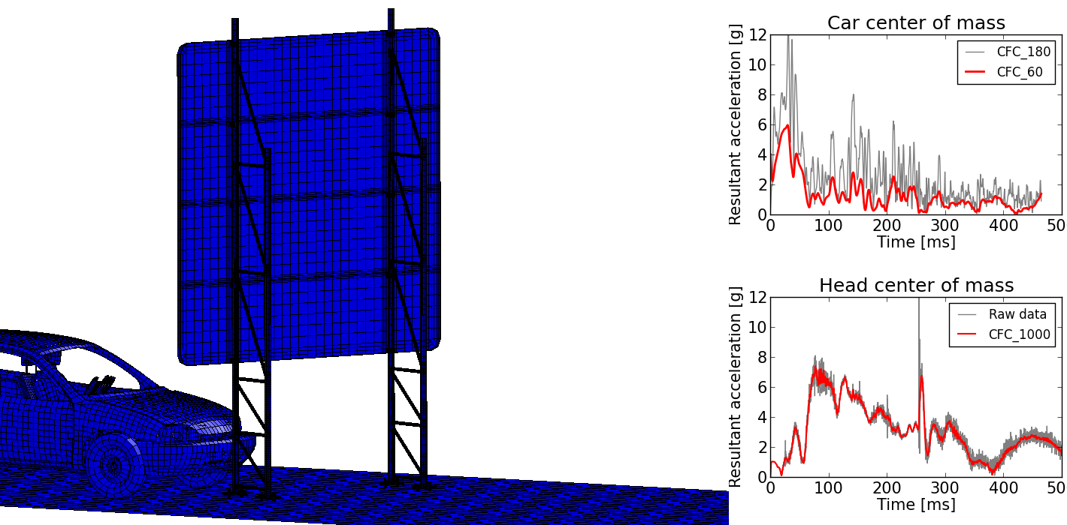
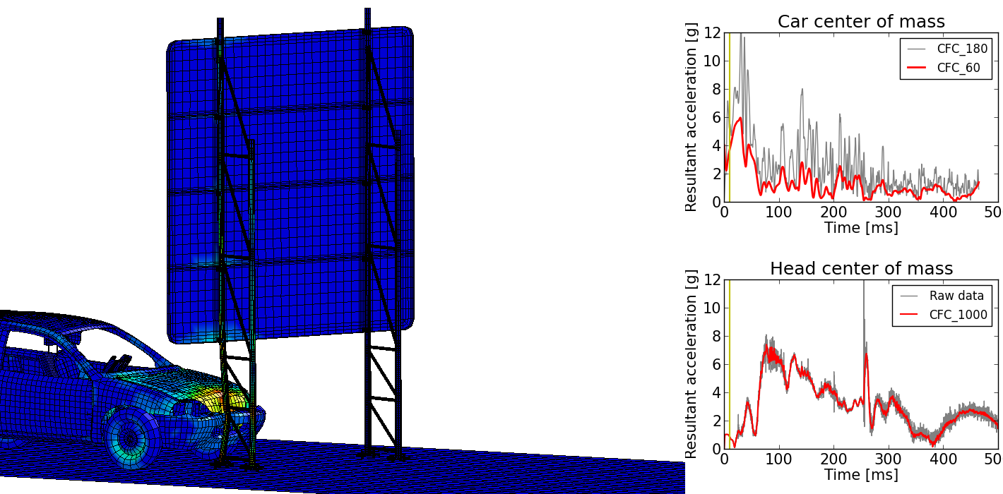
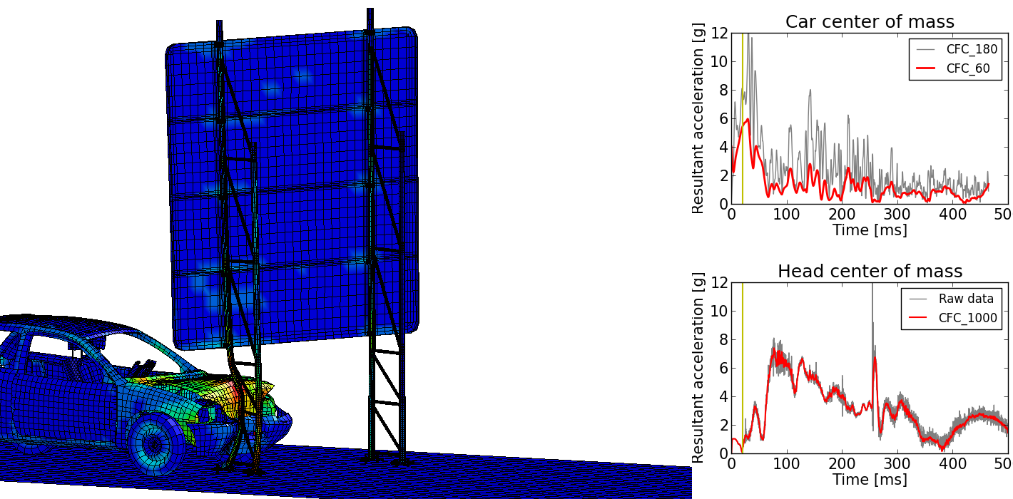
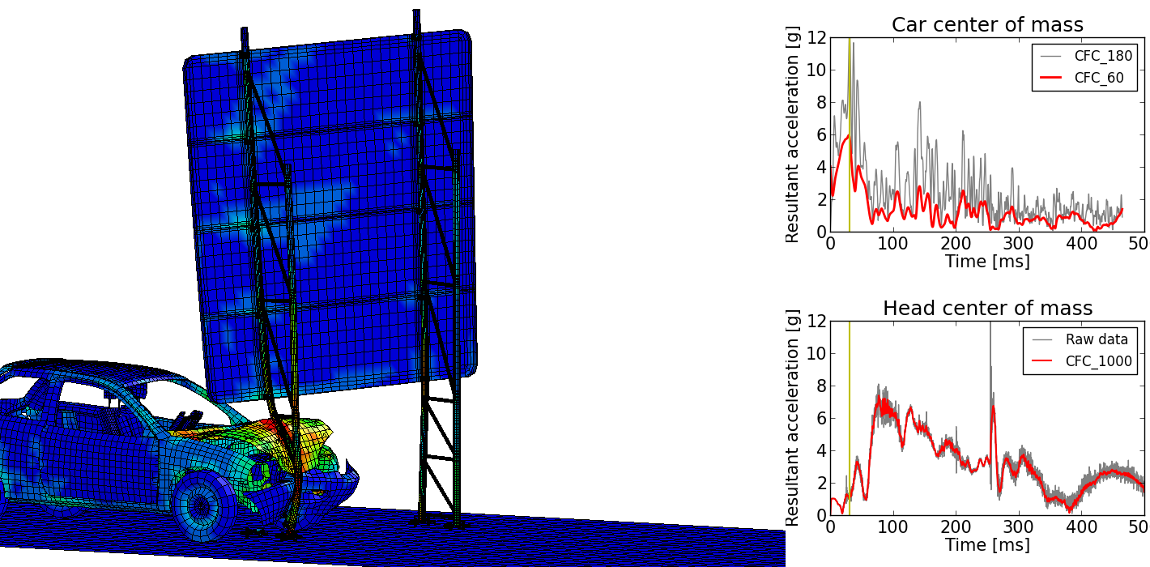
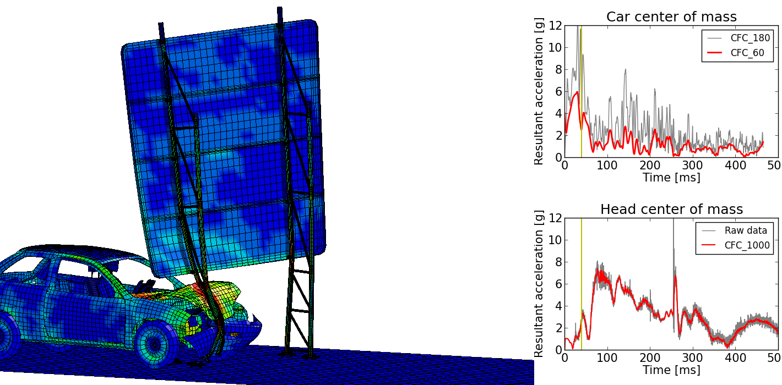
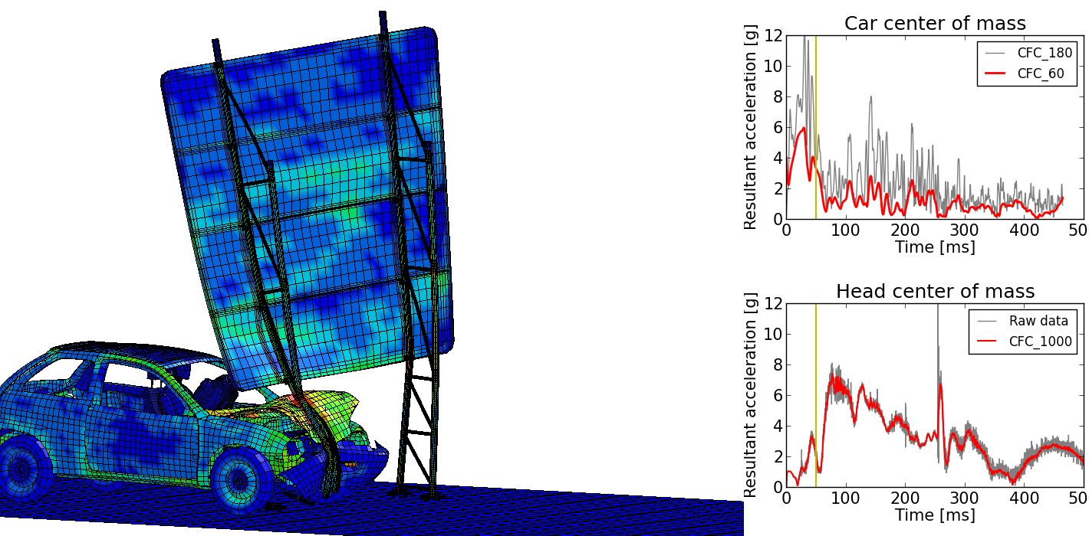
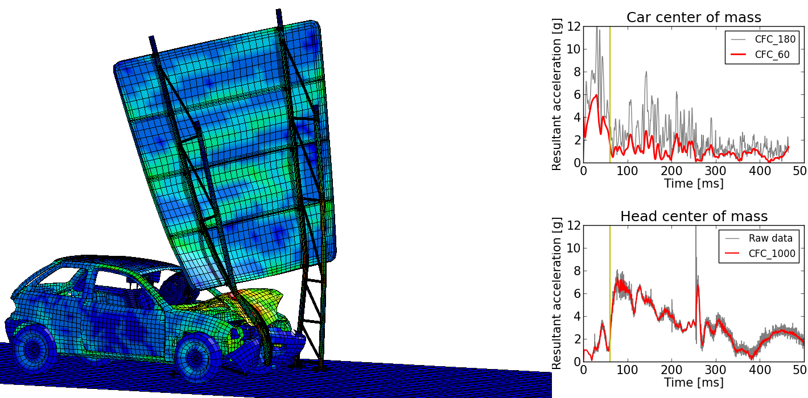
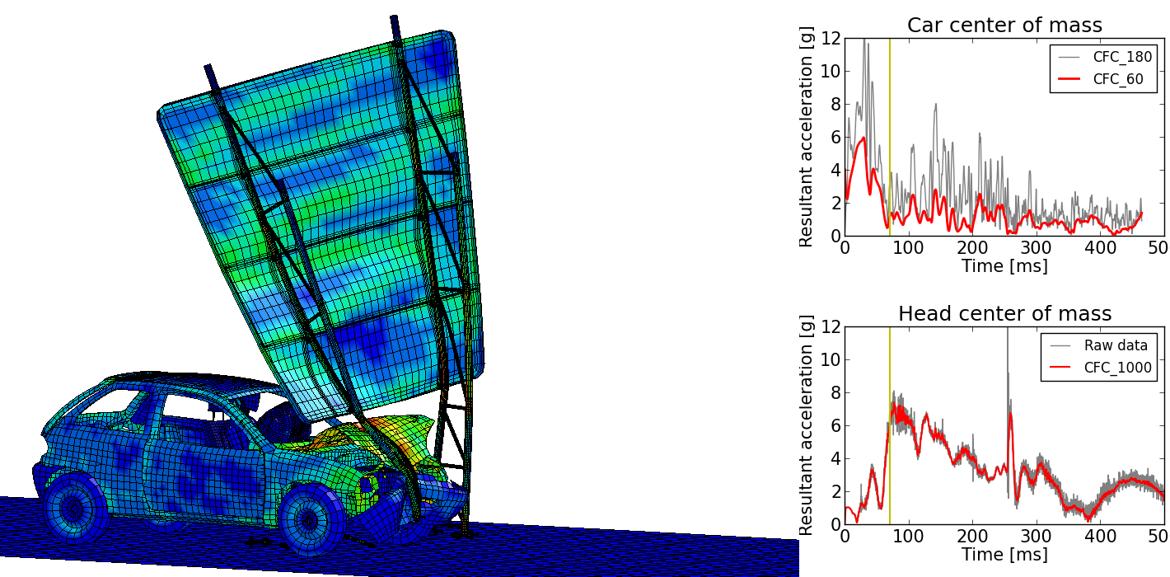
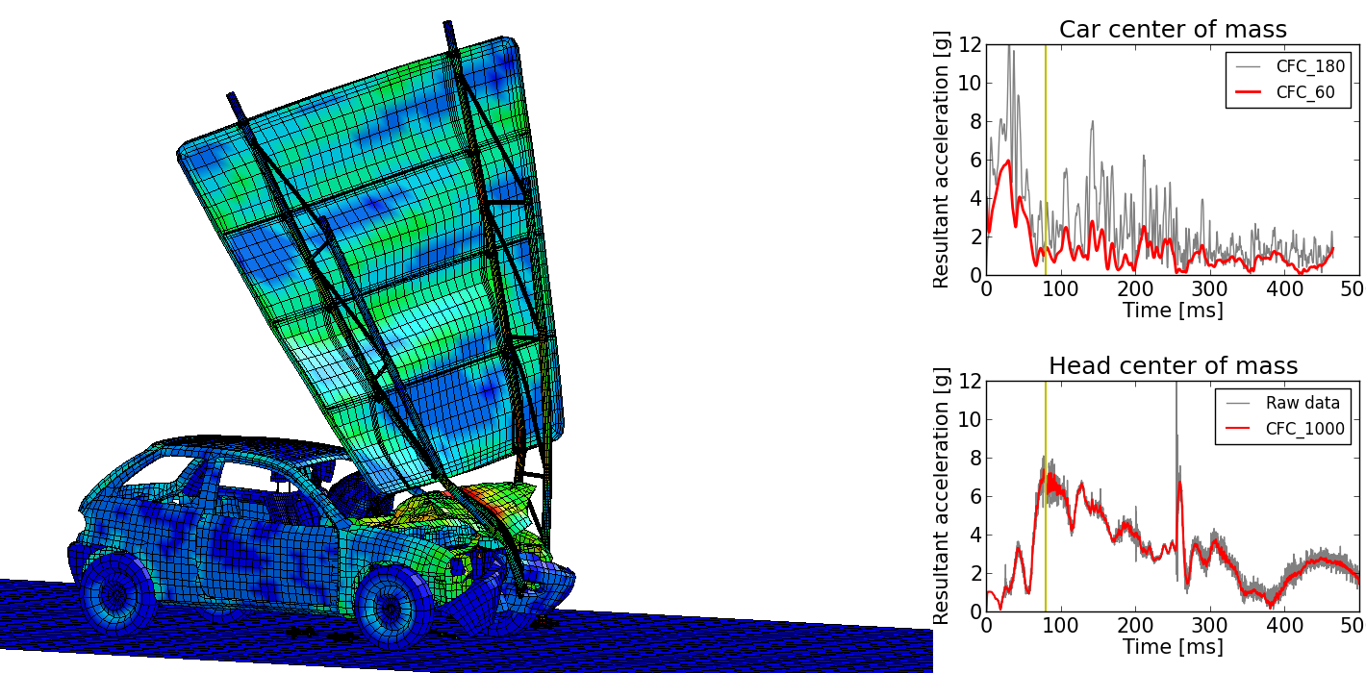
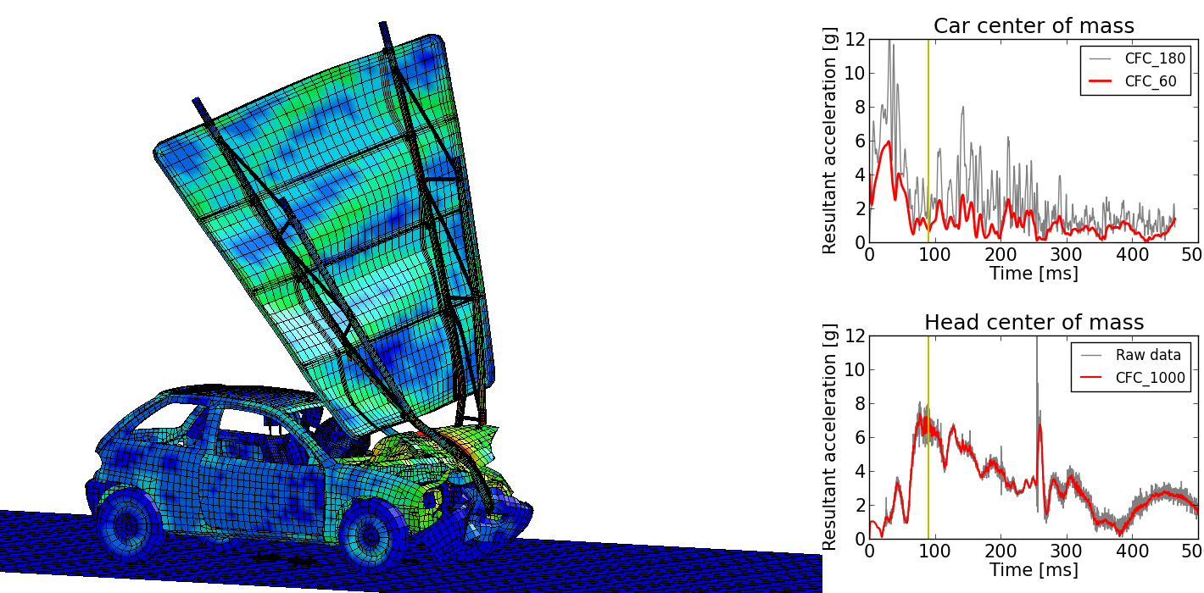
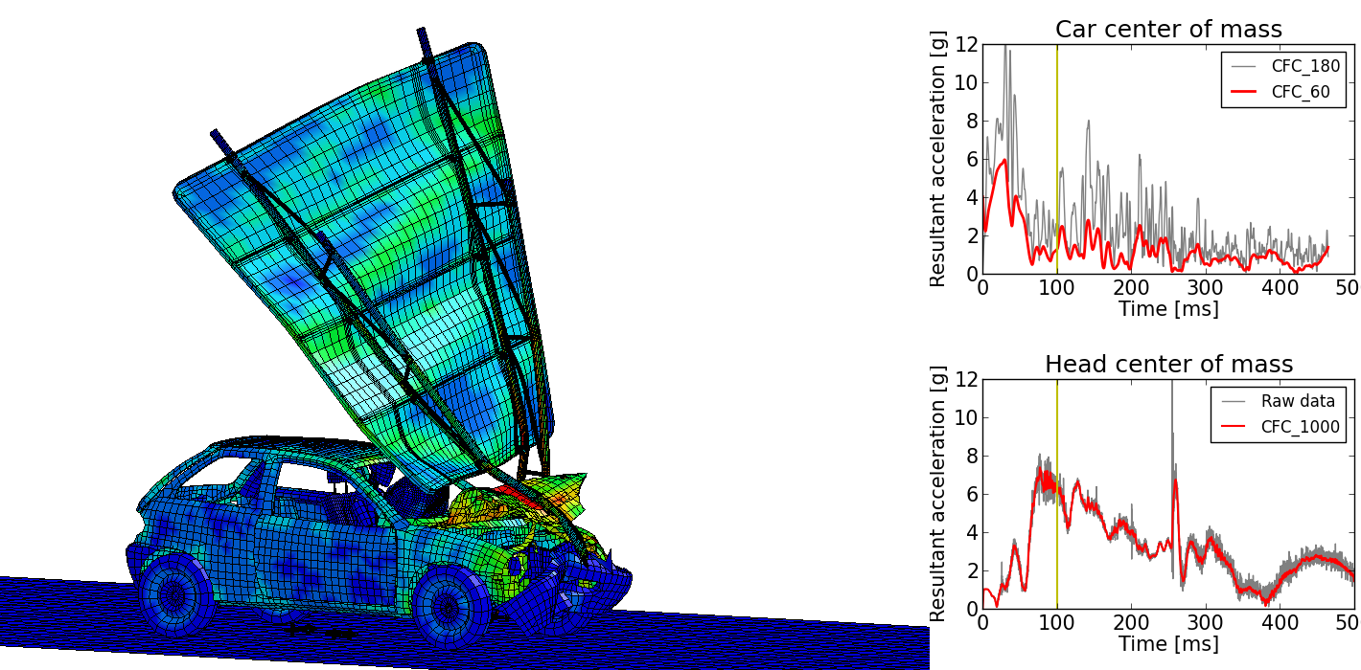
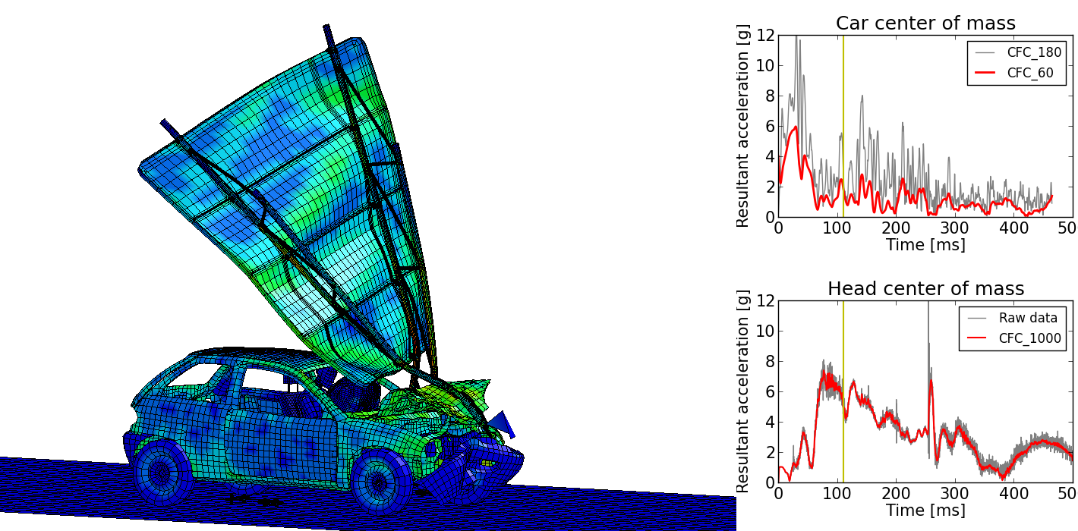
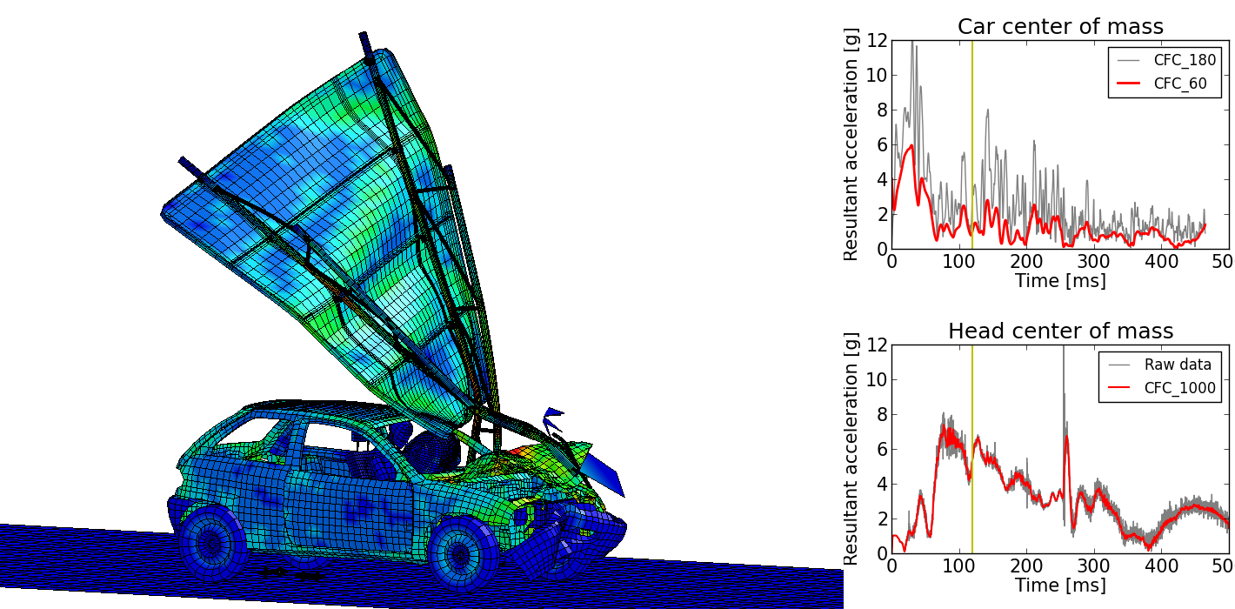
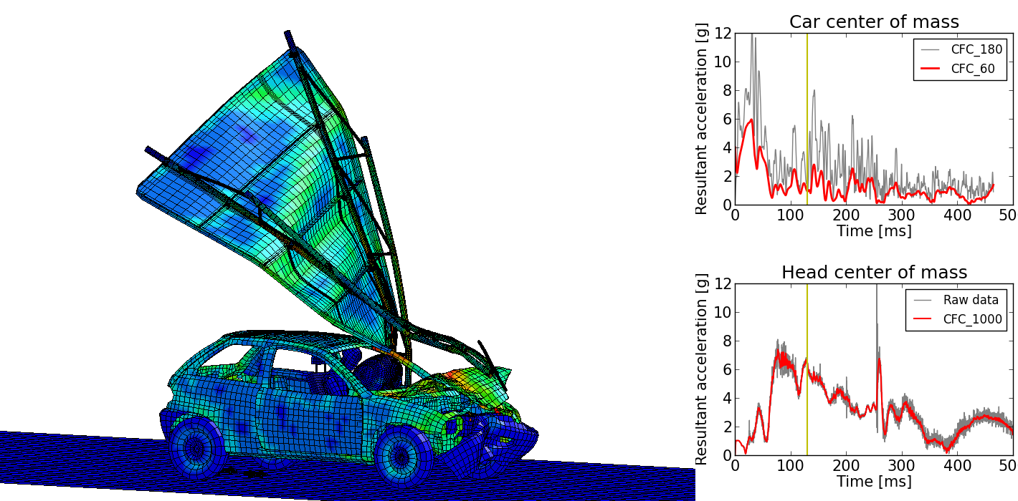
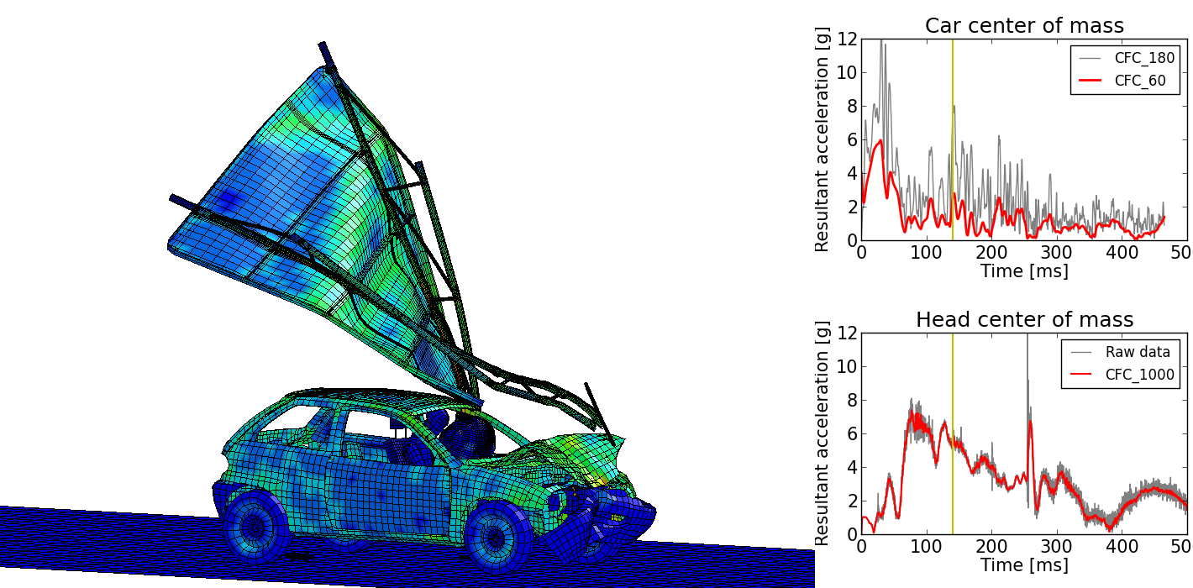
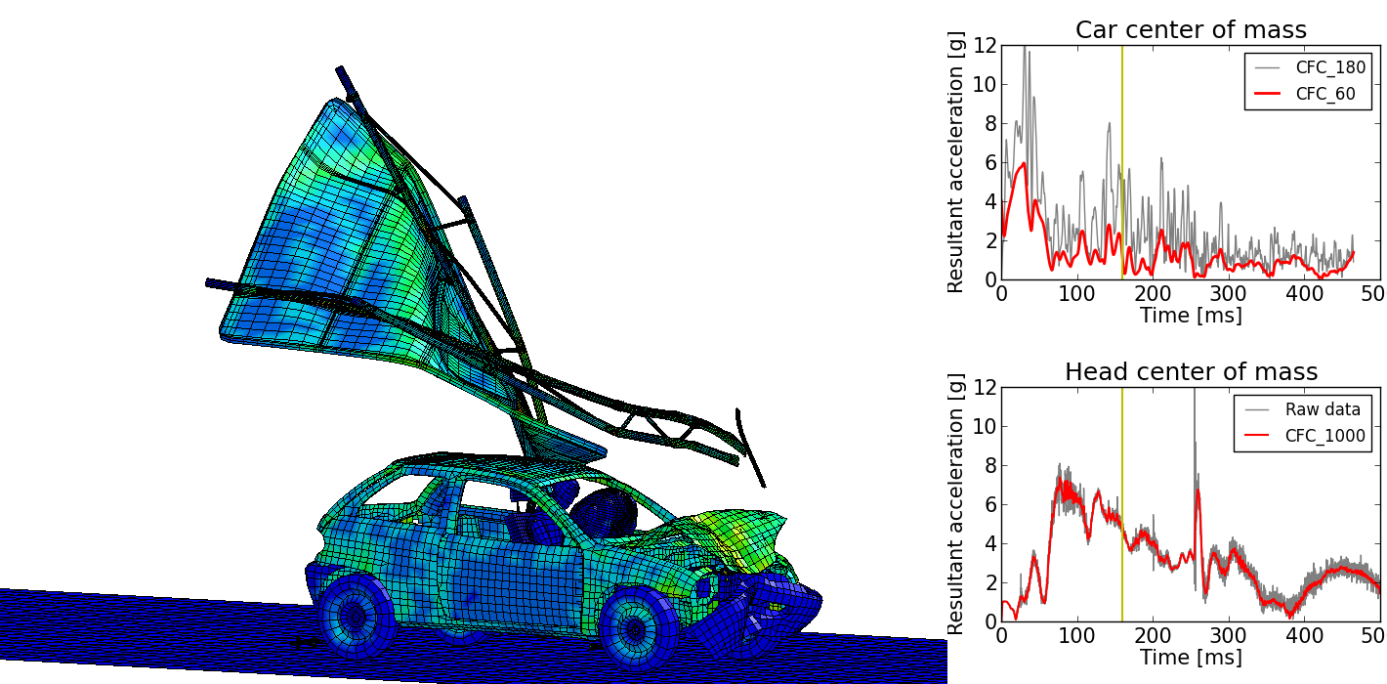
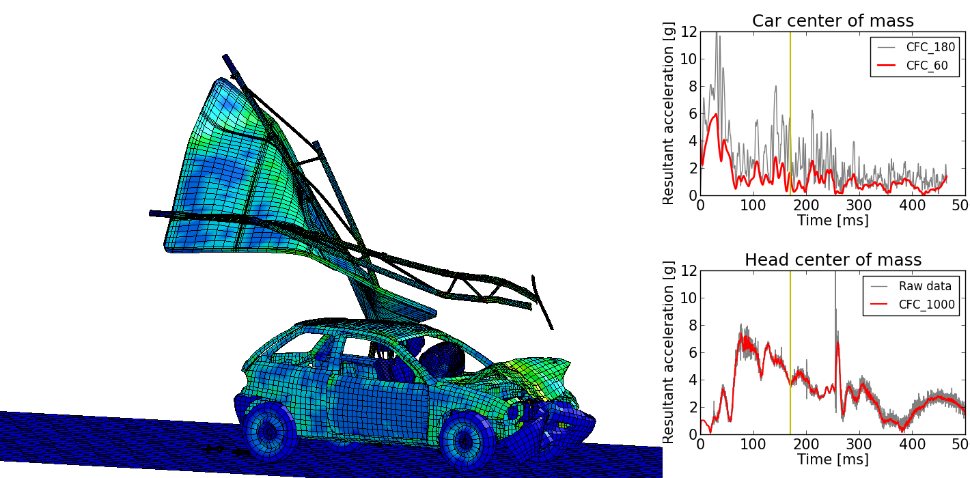
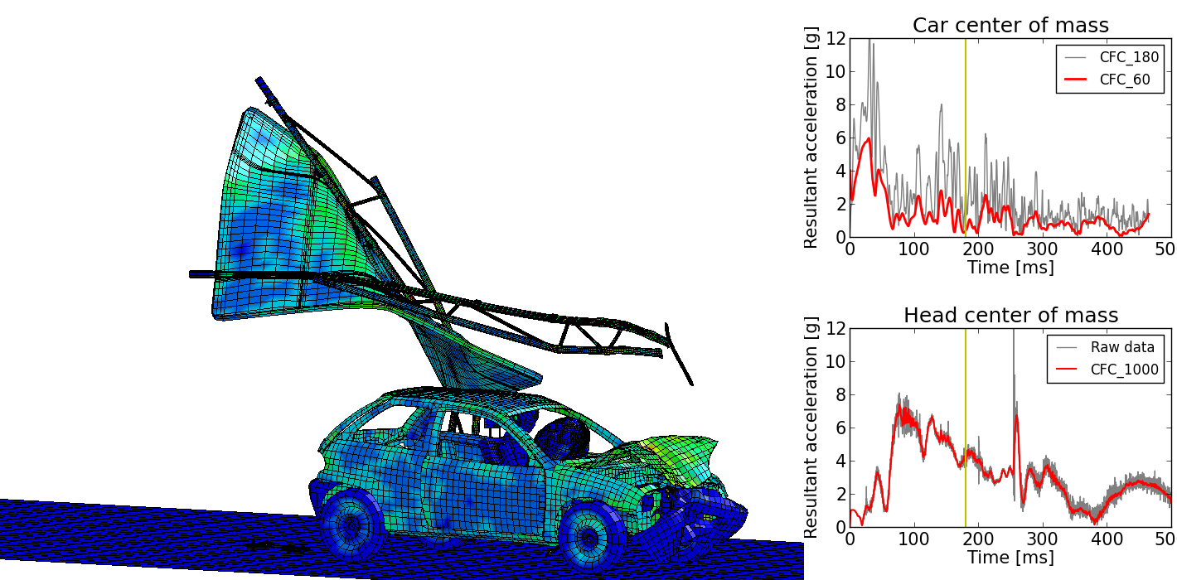
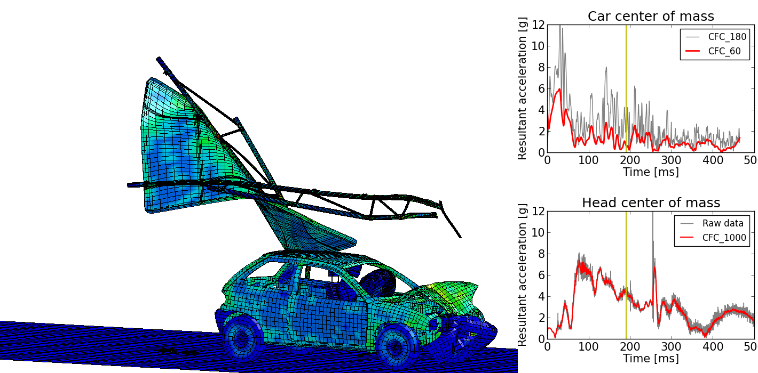
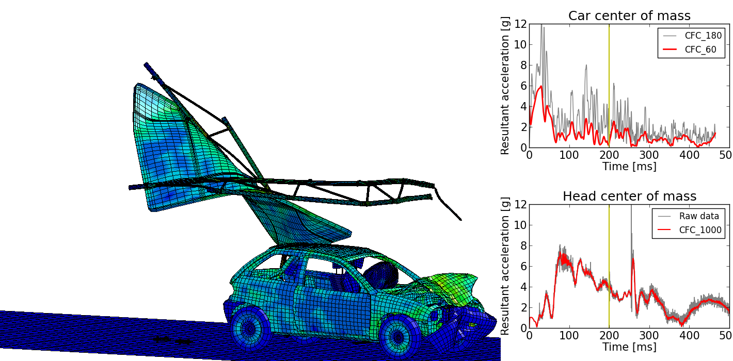
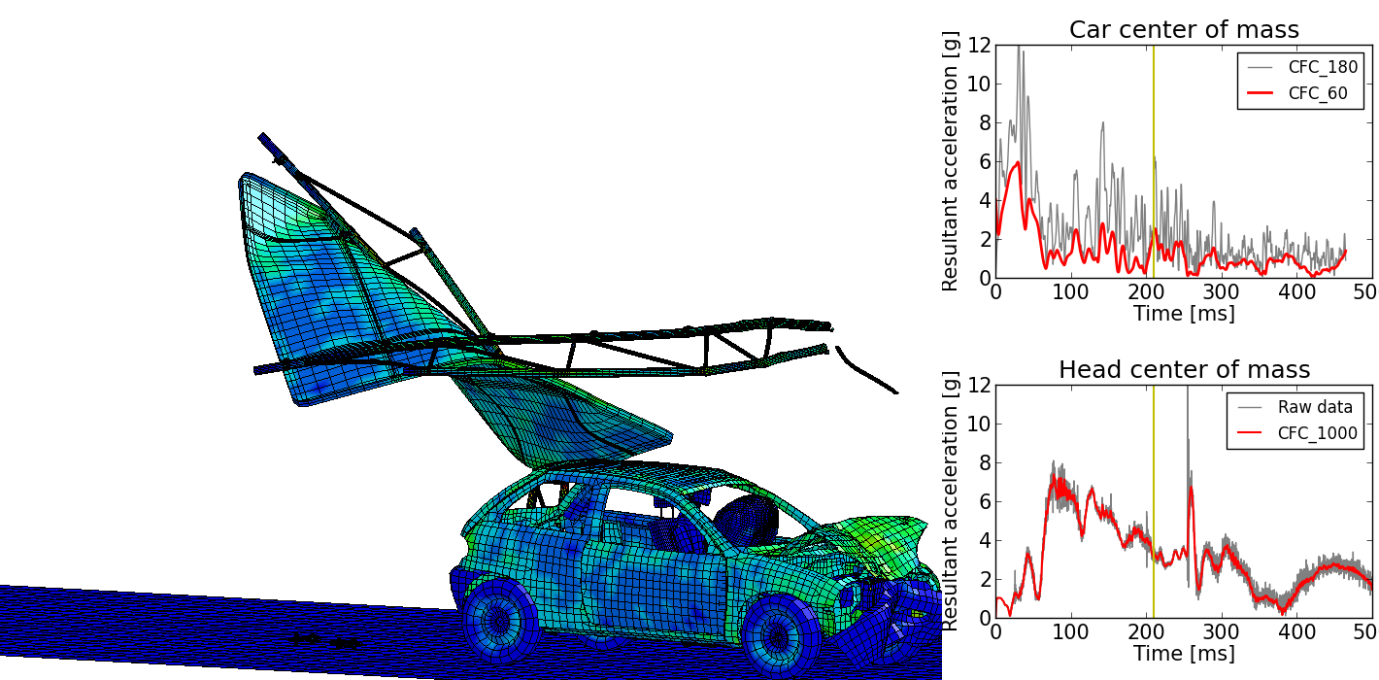
Crash test simulation
Results – speed = 100 km/h
Von Misses stresses in GPa

Slide 20
Crash test simulation
Results – accelerations
Car center of mass
Head center of mass

Slide 21
Crash test simulation
Results – Energy balance

Slide 22
Consideration of uncertainties
1 Introduction
2 Numerical model
3 Crash test simulation
4 Consideration of uncertainties
5 Conclusions

Slide 23
Consideration of uncertainties
Uncertainty
Structural analysis sufficient amount of uncertainty
Physical variation – aleatoric uncertainty randomness
Imprecise information – epistemic uncertainty fuzziness
Polymorphic uncertainty fuzzy randomness

Slide 24
Consideration of uncertainties
Uncertain variables
Variable |  | Uncertainty model
Impact speed | v, [km/h] | Fuzzy random variable
Impact angle | φ, [°] | Fuzzy random variable
Weld failure stress | σ_{u}, [GPa] | Fuzzy random variable
Weld failure strain | ε_{u}, [-] | Fuzzy random variable
Spring stiffness | K, [kN/mm] | Fuzzy variable
Welds
Elastic springs

Slide 25
Consideration of uncertainties
Parallel coordinate plot
Result variable:
HIC36
Failure:
HIC36 > 5.3

Slide 26
Consideration of uncertainties
Fuzzy Stochastic Analysis

Slide 27
Conclusions
1 Introduction
2 Numerical model
3 Crash test simulation
4 Consideration of uncertainties
5 Conclusions

Slide 28
Conclusions
Conclusions
Numerical simulations: efficient and accurate for impact tests
Explicit solution methods: most appropriate
Acceleration recordings: numerical noise
digital filtering
small sampling period
EN 12767: only impact severity measures
include occupant injury measures (HIC, NIC)
include speeds lower than 35 km/h
include considerations for numerical simulations
Fuzzy stochastic analysis for consideration of polymorphic uncertainty
Risk for occupant injury, practically negligible

Slide 29
Thank you!

Slide 30
Appendix
Numerical experiment

Slide 31
Appendix
Connection failure

Slide 32
Appendix
Explicit time integration

Slide 33
Appendix
Statistical evaluation of model and metamodel
Coefficient of Determination $R^{2}$
Multivariate linear and quadratic regression
$$R^{2}$$ | Linear regression | Quadratic regression
FE model | 77.5 % | 87.1 %
meta- model | 82.9 % | 87.9 %
$$R^{2}= \frac{{SS}_{tot}− {SS}_{res}}{{SS}_{tot}}=\frac{explained variance}{total variance}$$

Slide 34
Appendix
HIC and ASI calculation
Head Injury Criterion (HIC)
Acceleration Severity Index (ASI)
$$α= \sqrt{{α_{x}}^{2}+{α_{y}}^{2}+{α_{z}}^{2}}$$
$$α_{x} ,α_{y} ,α_{z}$$
Filtered with CFC_1000
$${\overline{A}}_{x} ,{\overline{A}}_{y} ,{\overline{A}}_{z}$$
Filtered with CFC_180

Slide 35
Appendix
Weld failure
Where

Slide 36
Appendix
$$μ_{HIC36} , σ_{HIC36} , P_{f,HIC36}$$
$${\tilde{μ}}_{HIC36} , {\tilde{σ}}_{HIC36} , {\tilde{P}}_{f,HIC36}$$
$$HIC36$$

